Slide 1
Santiam Wagon Road:
Self Guided Tour
Group 43 Progress Report and Overview Presentation

Slide 2
Project Introduction
Self guided tour
Mobile application for interpretive events
What is an interpretive event
Content creation tools for Ranger service volunteers

Slide 3
Project Conception
Our sponsor, Nancy Hildebrandt, is a volunteer for the Sweet Home Ranger District. She attended a tour led by local archaeologist Tony Farque and was surprised to learn that much of the information about the local Santiam Wagon Road was undocumented and not in a published or written form.

Slide 4
Project Rationale
Modernize park service
Current tech is signs and cassette players
Reduce maintenance costs and labor
Sign wear & tear
Vandalism
Lost/Damaged audio equipment
Improve visitor experience
Create a growing, dynamic knowledge base of local experts

Slide 5
Project Restrictions
Low, if any, recurring and startup financial costs
Internet connection must not be required while taking a tour
Mobile Applications must be free of charge
All public content must be reviewed prior to publishing
Must rely on open source software whenever possible

Slide 6
Our Solution Overview
Three primary components:
Content Packages
Zip archives of tour multimedia assets and map information
Pre-downloaded allowing complete offline access while on a tour
Web Control Panel
Provides administration interface for overall system
Allows for creation and publishing of tours
Mobile Applications
Cross platform between iOS and Android
Shows and download available tours
Act as virtual tour guide

Slide 7
Content Packages

Slide 8
Content Packages
Our solution to not having Internet access
Content Packages can be pre-downloaded wherever a user has Internet access
Content Packages contain all relevant files for a guided tour, including:
Video content
Audio recordings (for smaller downloads)
Additional text information
The Sweet Home Ranger Station is attempting to get equipped with public WiFi for this purpose

Slide 9
Content Package Structure
Zip file
Contains:
Bounding coordinates for a map
List of waypoints
Each waypoint has a folder containing all relevant videos, audio, or text resources.
Metadata file
Contained in root of zip file
Lists overall description and file verification hashes

Slide 10
Web Control Panel

Slide 11
Web Control Panel
Provides mechanisms for:
Creating new tours
Auditing and approving candidate tours for publishing
Managing published tours
Primary interface for content curators

Slide 12
Creating a Tour
Heavy emphasis on content creation usability
Tour creation wizard will walk the curator through each step
Primary steps will be:
Select map region
Place waypoints on points of interest
Add descriptions to waypoints
Add any relevant files to each waypoint
Add description of entire tour
Submit for publishing

Slide 13
Tour Audits
Tour files will be automatically scanned for known malware once they are uploaded
Tours will need to be reviewed by a configurable number of reviewers
Each reviewer will go through all descriptions and content looking for errors or inappropriate content
Only once content has properly combed through may it be released for publishing

Slide 14
Mobile Applications

Slide 15

Mobile App
iOS (Jiawei) and Android (Charles)
www.computerworld.com
Notes:
http://www.computerworld.com/article/2854392/ios-trumps-android-in-mobile-shopping-so-what.html

Slide 16
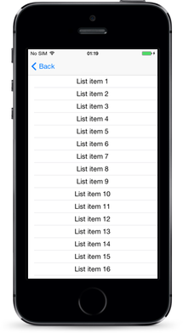
Viewing tours
Users can see all available tours
Users can select and download tours
NSURL - iOS
Download Manager - Android
nativescript.org
Notes:
http://docs.nativescript.org/angular/ui/components

Slide 17
Tours
Display map of area - Stretch of the Santiam wagon trail
Current location
Location of points of interest (waypoints)

Slide 18
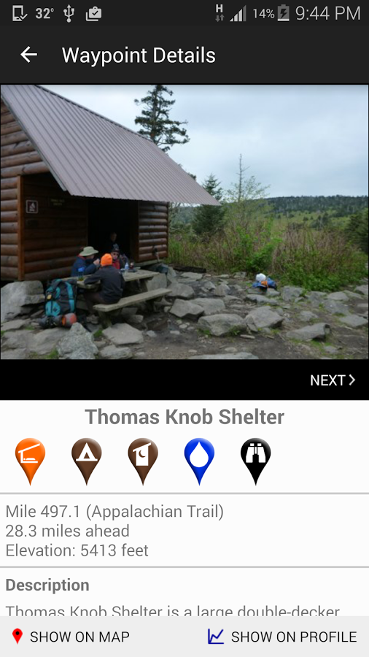
Waypoints
Text descriptions
Audio recording of tour guide
Videos showing local experts at the tour locations
Included in downloaded tour package
play.google.com
Notes:
https://play.google.com/store/apps/details?id=com.highsierraattitude.atcomplete

Slide 19

Disability Accessibility
Video closed captioning
Transcriptions of audio recording
newschannel6now.com
Notes:
http://www.newschannel6now.com/story/19765146/disability-simulation-activity-to-help-raise-awarenss-in-texoma
Design to be accessible for the hearing impaired

Slide 20
Conclusion

Slide 21
Issues Faced
Licensing, avoiding proprietary software
MIT
BSD
LGPL v2+
Team communication
Minimal finances
Map downloading and rendering

